Slide 1

Build an Android App – Week 4
Jon Douglas

Slide 2
Last Week Review
Did you complete week 3’s lab?
How did it go? Any issues?
Any questions from last lecture?
Remember what object oriented programming is?
What are Intents?
Remember how to grab resources via code and xml?

Slide 3
So you want to be an Android developer…
Here’s the truth…You’ve done much more in the last 4 weeks than many people have done in their lives which is…Learning to program.
You learned about the basics of Android, XML, and your choice of a programming language (Java / C#)
Now let’s talk about the other skills you will want to polish to get you well on your way after this course.

Slide 4
Technical Skills(Pt 1)
General Programming Skills (Java / C#)
Object Oriented Programming
Basic Problem Solving Skills
Ability to pickup new languages

Slide 5
Technical Skills(Pt 2)
Android SDK: - A basic understanding of layouts and views
- Activities and their lifecycle
- User input
- Getting data from the web
- Storing data
- Collection views, Adapters
- Toolbar
- Sizes and Densities

Slide 6
Technical Skills(Pt 3)
Getting data from the web via Web Services
What is REST and how can we consume APIs?
In other words…How can I get data from a service like Facebook, Instagram, etc into my application for my users?

Slide 7
Technical Skills(Pt 4)
Source Control (Git)
- Allows you to store your projects online
- Allows you to maintain changes to your projects in an orderly manner
- Helps you create a process for developing your application
Notes:
CMD+OPTION+8 TO ZOOM

Slide 8
Non-Technical Skills(Pt 1)
Passion
Employers are typically looking for the most passionate people when filling a position. Passion can be quite a loaded word as it can mean many different things. What does passion mean to you? Are you passionate about your work? Are you passionate about the technology you work with? Are you passionate about the company's mission?
Notes:
CMD+OPTION+8 TO ZOOM

Slide 9
Non-Technical Skills(Pt 2)
Collaboration / Being a team player
Secondly, employers want to ensure you're a good team player. Do you bring up ideas whether they are good or bad to the table and provide feedback? Do you go out of your way to make a process better by collaborating with others?
Notes:
CMD+OPTION+8 TO ZOOM

Slide 10
Non-Technical Skills(Pt 3)
Writing
How clear can you get your points across? In this day and age, there's not much time to read every single email or message we get. Being able to clearly express thoughts and ideas to others is a skill that is priceless.
Notes:
CMD+OPTION+8 TO ZOOM

Slide 11
What employers want to see…
One published application
Employers want to see the fact that you've gone through the whole process of publishing an application to the app store. This shows that you've gone the extra mile and went from an idea for an application to being able to download it from any Android device.
Notes:
CMD+OPTION+8 TO ZOOM

Slide 12
A College Degree (Optional)
In my opinion, a college degree is not needed for most development jobs. Most employers however will ask for a college degree or equivalent experience in the field. In this day and age, there is so much information out there to learn from. I find that one can easily prove their worth by publishing apps, open sourcing their projects, and simply by practicing programming.
Notes:
CMD+OPTION+8 TO ZOOM

Slide 13
What makes an App good?
- It does one thing extremely well
- It's loyal to it's audience
- It's fast and reliable
- It feels polished with a nice design
- It's straight to the point
Notes:
CMD+OPTION+8 TO ZOOM

Slide 14
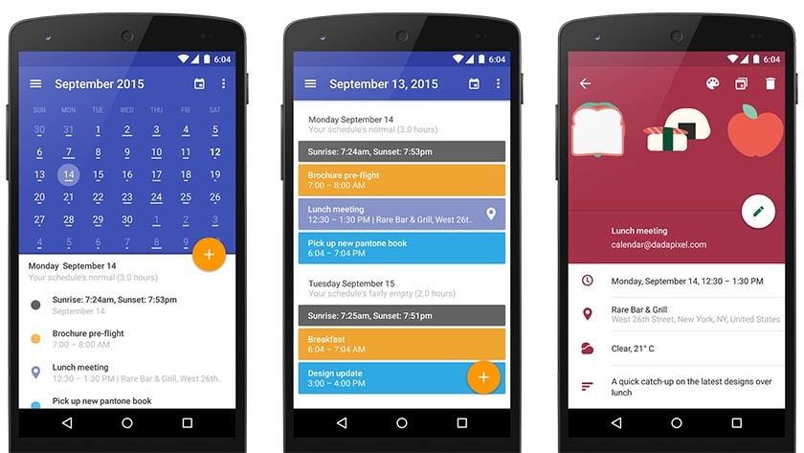
UI / UX Design (User Interface / User Experience)
Notes:
CMD+OPTION+8 TO ZOOM

Slide 15
Responsiveness
Notes:
CMD+OPTION+8 TO ZOOM

Slide 16
Features
It does one thing right, and it does it well
It doesn’t include every bell and whistle known to man
It is well thought out so that the user has to do as little amount of work as possible
It doesn’t deter the user from other features
Notes:
CMD+OPTION+8 TO ZOOM

Slide 17
What kind of application do you want to build?
Let’s take a few minutes to go around the classroom and ask each person what type of application they want to build or an idea for an app they want to build.
Notes:
CMD+OPTION+8 TO ZOOM

Slide 18

App #4 – Build Your Own App
Design and implement a single screen from your favorite application you use on a daily basis.
Notes:
CMD+OPTION+8 TO ZOOM

